Slide 1

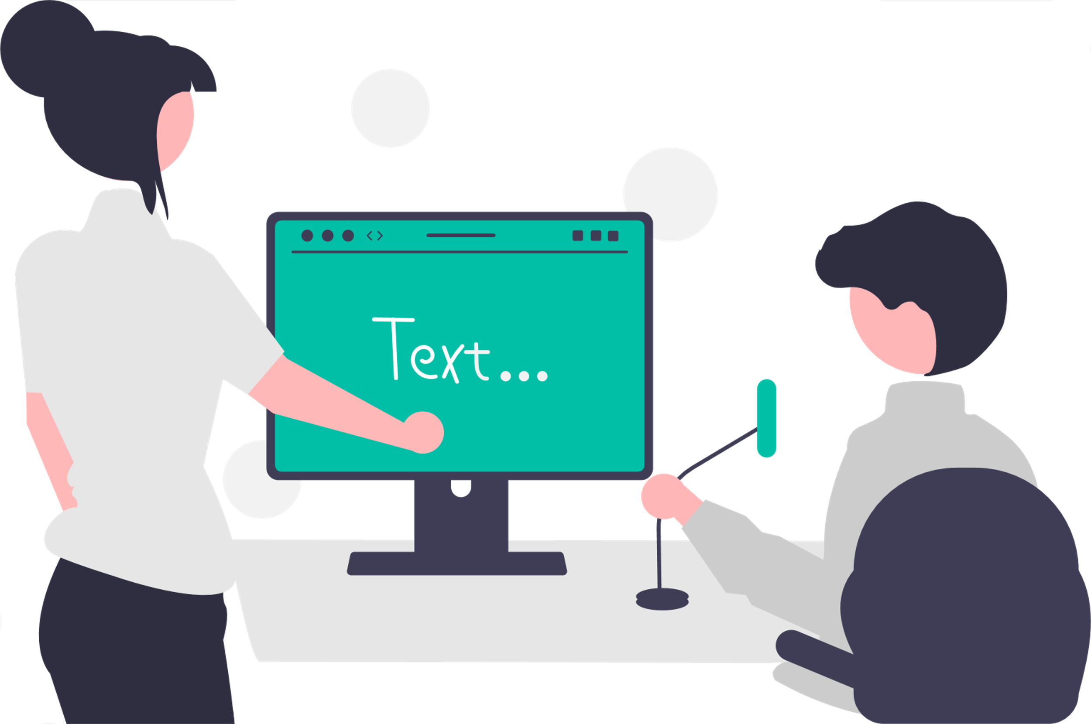

End-to-End Translation of Contemporary Egyptian Arabic Dialect
Project ID: AI_Microsoft1_May2022​
Team ID: AI-5
Presented by:​
Eman Ahmed Abdelaziz Mohamed, 300327278​
Yomna Mohamed Sayed, 300327217​
Sondos Mohammed Hussein Ali, 300327219​
Alaa Tohamy Mohamed Abdelwahab, 300327227
Ahmed Abdo Amin Abdo, 300327306​

Slide 2

Problem Definition:- According to there is no speech translation model based on the end-to-end architecture for the Egyptian dialect language, so we will deploy a model that can be supported as a service to understand Egyptian dialect. Our project is based on identifying the human voice audios extracted from films and YouTube videos and converting them into text to make communication easier.
Eman Mohamed: 300327278
Potential Benefits to Sponsor/Users:
People can communicate easily without studying the entire language .
companies can offer training and other eLearning in a multilingual format.
As a business, we can sell our service to multiple websites such as YouTube to enhance the speech translation of Egyptian dialect.
Project Mentor:
○ Dr. Soha Makady
Project Sponsor:
○ Dr. Ahmed Tawfik
Project uOttawa support:
○ Dr. Wail Mardidni

Slide 3
Eman Mohamed: 300327278
Project Flow Chart:-
Collecting Data
Extract Transcript
Data Segmentation
Making Metadata
Using vse tool
Using subtitle edit tool
Input: Egyptian video with its English transcript
Input: Egyptian video
Output: Egyptian video and its English transcript
Input: Egyptian video and its English transcript
Output: Egyptian audios and its English transcript
Input: Egyptian audios and its English transcript
Output: metadata file (name audio and its transcript)
Deployment
(Website)
Evalution
Training using End To End pretrain model
Apply Feature Extractor
Input: Egyptian audio or recording voice
Output: English text (translated)
Input: log mel Data
Output: Trained End To End pretrain model
Input: ​ Metadata and audios ​
Output: ​ Log mel frequency

Slide 4
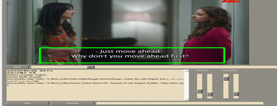
Critical Requirements 1 :-
Yomna Mohamed:300327317
Low resource language.
Collecting data manually.
Solution Design:-
Video-subtitle-extractor (VSE)
Since there are no sources for Egyptian dialect datasets, we collected 400 hours of Egyptian dialect audios and extracted their English transcripts, from television shows, and YouTube videos and Egyptian movies.
Using the open-source, free tool Video-subtitle-extractor (VSE) to extract subtitles from videos which haven’t contain their transcripts.

Slide 5

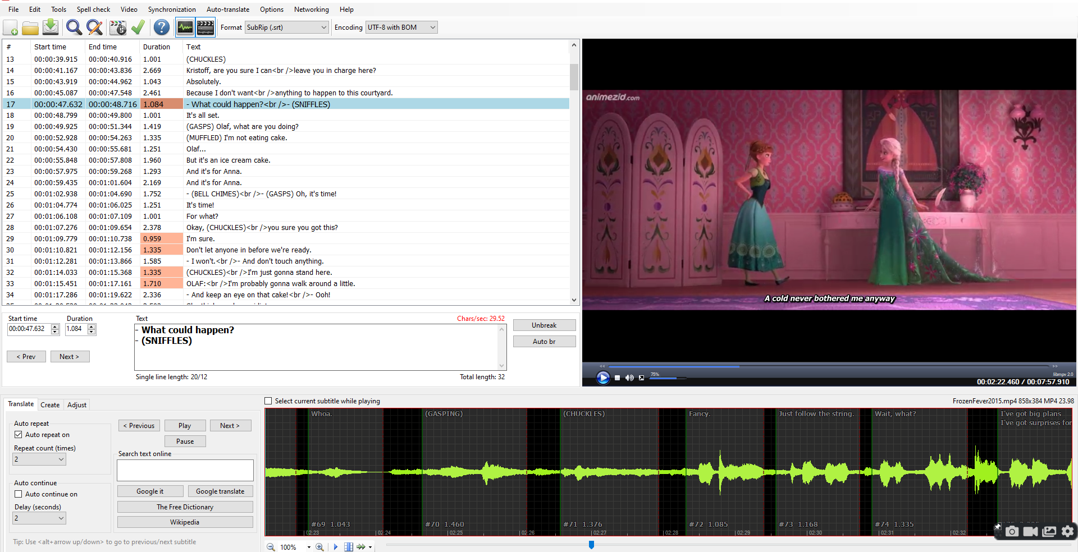
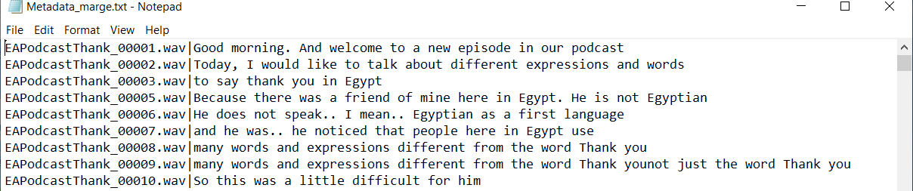
Critical Requirements 2 :-
Yomna Mohamed:300327317
Data Segmentation.
Making Metadata.
Subtitle Edit 3.6.7
Solution Design:-
Using subtitle Edit tool for applying the data segmentation and cutting the videos into small audios maximum 12 second in length and exporting its sentences in file (*.txt).
Using python script (MateData-make.py) for renaming wav files and making Metadata file (*.txt) that contain the wav file name and its transcript.
The final MetaData.txt

Slide 6
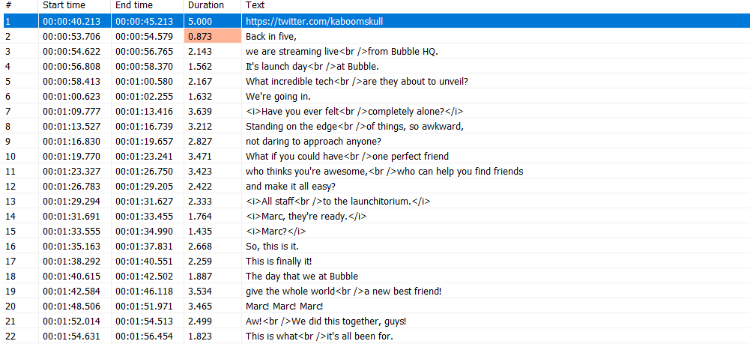
Top Challenges have been Managed (Risks and Mitigation)
There was a synchronization issue between the audio and its translation, where the voice comes before the translation, or the translation comes before the voice.
There were special characters such as: (*) , (♪), (@), ?, -, #, _ and sound effects in the subtitle files.
Solution:
Created a Python script "srt-resync.py" for synchronization issue.
Created a python script "filter-subtitles.py" to :
1- Removes font tags and text contained with,
subtitle entries containing asterisks, author tags, and
lone symbols.
2- Removes sound effects and text contained with like "BOOOM".
3- Replaces names with dashes.
4- Fixes erroneous comma spacing.
Sondos Ali: 300327219
After applying filer-subtitlies.py

Slide 7

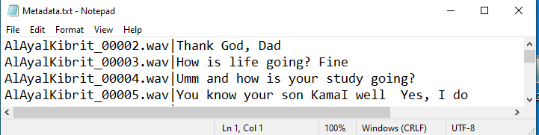
Top Challenges have been Managed (Risks and Mitigation) Cont.
After data segmentation, there are some audios meaningless, so we made a Python script (wav-Merge.py) to merge audios less than 5 sec together.
as shown in figure (After applying wav-Merge.py)
.
Sondos Ali: 300327219
Before applying wav-Merge.py
Merge
After applying wav-Merge.py

Slide 8

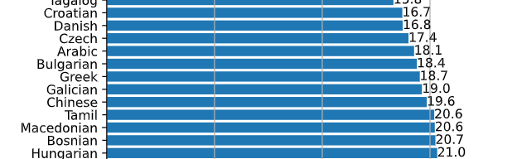
Critical Requirements 3 :-
Eman Mohamed :300327278
End to End model architecture.
Pre trained model on Arabic language.
Get the baseline
Solution Design:-
Whisper is an automatic speech recognition (ASR) system trained on 680,000 hours of multilingual and multitask supervised data collected from internet.
The Whisper architecture is end-to-end approach,
It used Python 3.9.9 and PyTorch 1.10.1 to train and test models
Whisper word error rate (WER) is 17.4 in Arabic language.

Slide 9
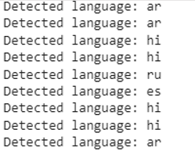
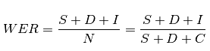
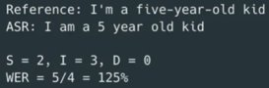
Baseline:
Eman Mohamed :300327278
We got our baseline after testing the whisper pretrained model on our data and we got a WER with a value 121.657, And the model did not recognize most of the audios language correctly
Evaluation metric (WER) :
is a measure of how accurate an Automatic Speech Recognition (ASR) system performs.
Where:
S is the number of substitutions,
D is the number of deletions,
I is the number of insertions,
C is the number of correct words,
N is the number of words in the reference (N= S+D+C)
Example:

Slide 10
Eman Mohamed :300327278
Source of errors in WER:
Factors that can affect WER, without necessarily reflecting the capabilities of the ASR technology itself, include:
Recording quality
Microphone quality
Speaker pronunciation
Background noise
Unusual names, locations, and other proper nouns
Technical or industry-specific terms

Slide 11
Critical Requirements 4 :
Alaa Basuny 300327227
Un-padded labels.
feature extraction
Solution Design:-
Using The data collator for a sequence-to-sequence speech model that treats the input_features and labels independently
The input_features are padded to 30s and converted to a log-Mel spectrogram of fixed dimension by action of the feature extractor and convert the input_features to batched PyTorch tensors.
For un-padded labels, we first pad the sequences to the maximum length in the batch using the tokenizer's .pad method, then cut the BOS token from the start of the label sequence as we append it later during training.

Slide 12
Critical Requirement 5: 1- fine tuning whisper model 2- Evaluation
Alaa Basuny 300327227
fine-tune the multilingual version of the "small" checkpoint with 244M params (~= 1GB)
Define the training configuration:
- max_steps
- save_steps
- learning_rate=1e-5 "The initial learning rate for AdamW optimizer"
- train_batch_size
- eval_batch_size
- metric_for_evaluation

Slide 13
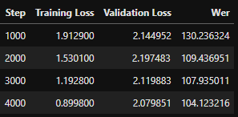
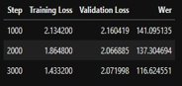
Alaa Basuny 300327227
Training cases :
No. Of Trained Hours ​ | Batch size​ | Max steps​ | Results (WER)​
5​ | 8​ | 4000 | 125
20​ | 8​ | 4000 | 112
30​ | 8​ | 3000 | 116.6​
30​ | 16​ | 4000​ | 104.1​
Training cases with 30H :
We trained our model with the max hours that our resources could handle which is 30H with different batch size once 8/batch, and another with 16/batch and we got that:
The model with batch size of 8 gave us 104.12 WER and the validation loss decreased which means the model converges –figure 1
The model with batch size of 16 gave us 116.6 WER and, the validation loss increased which means the model had an overfitting problem- figure 2
figure 1
figure 2

Slide 14
Evaluation:
Alaa Basuny 300327227
We evaluated the model using the word error rate (WER) metric same as the baseline metric
We defined a function "compute_metrics" that takes our model predictions and returns the WER metric.
replaces -100 with the pad_token_id in the label_ids
then decodes the predicted and label ids to strings.
Finally, it computes the WER between the predictions and reference labels on test data "6h".

Slide 15
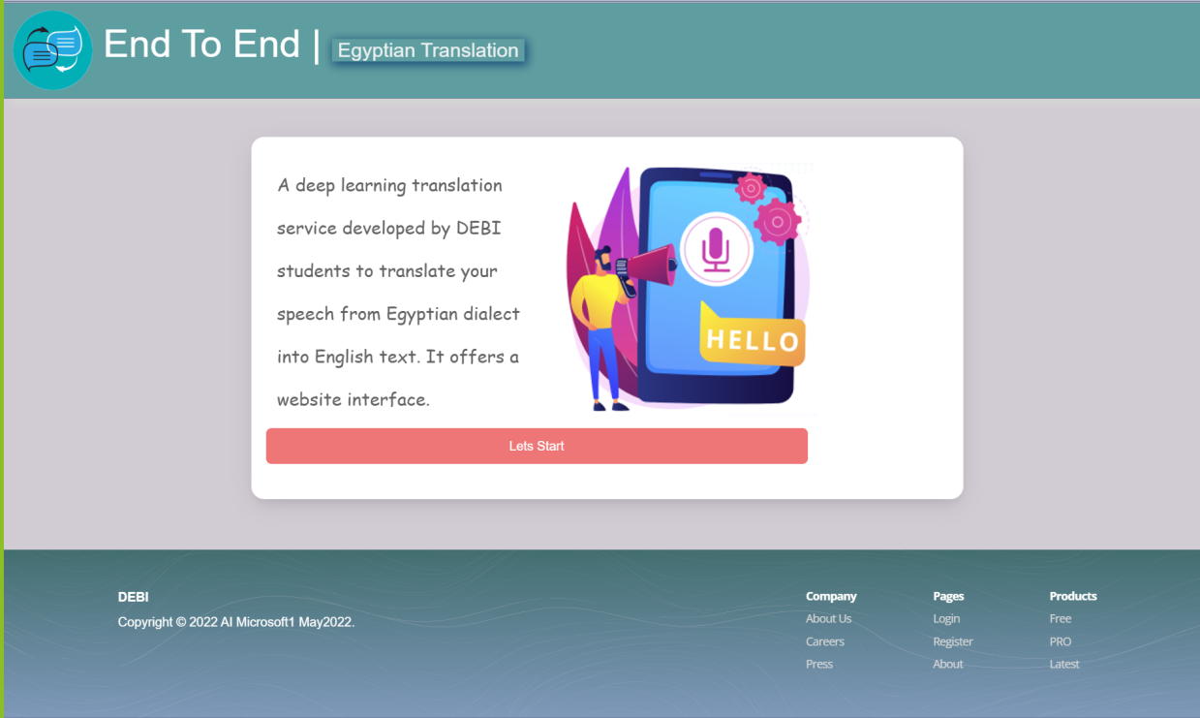
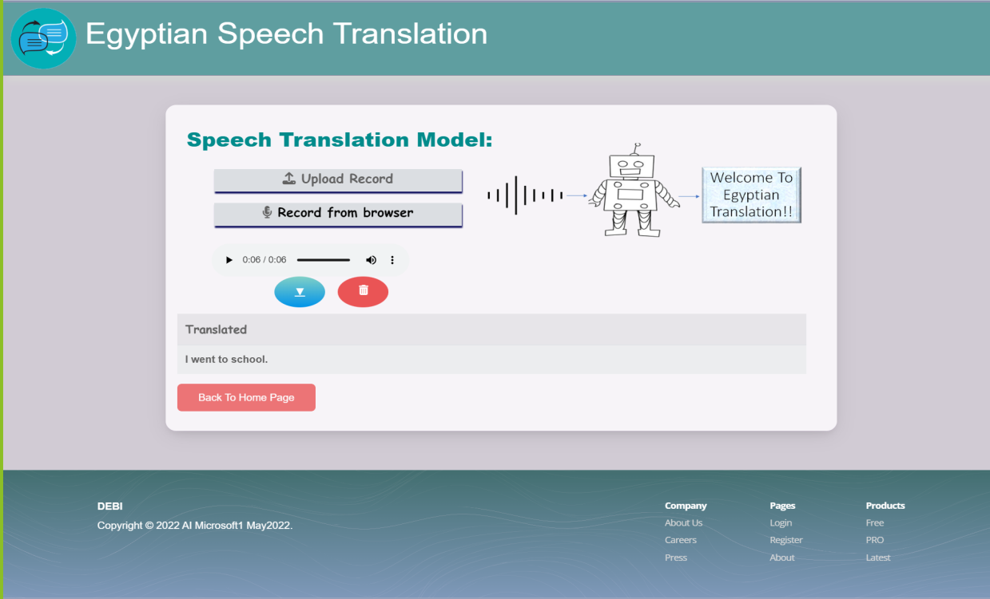
Critical Requirements 6 :
Ahmed Abdo :300327306
Designing a web interface.
Connecting user interface with our model.
Solution Design:-
Using HTML , CSS and JavaScript for the design.
Using a flask library to connect our model with the user interface.
Input: Egyptian audio file or voice recording through two options:
The user can upload audio using button (Upload Record)
The user can record his voice on browser using button
(Record from browser)
Output: English Text

Slide 16
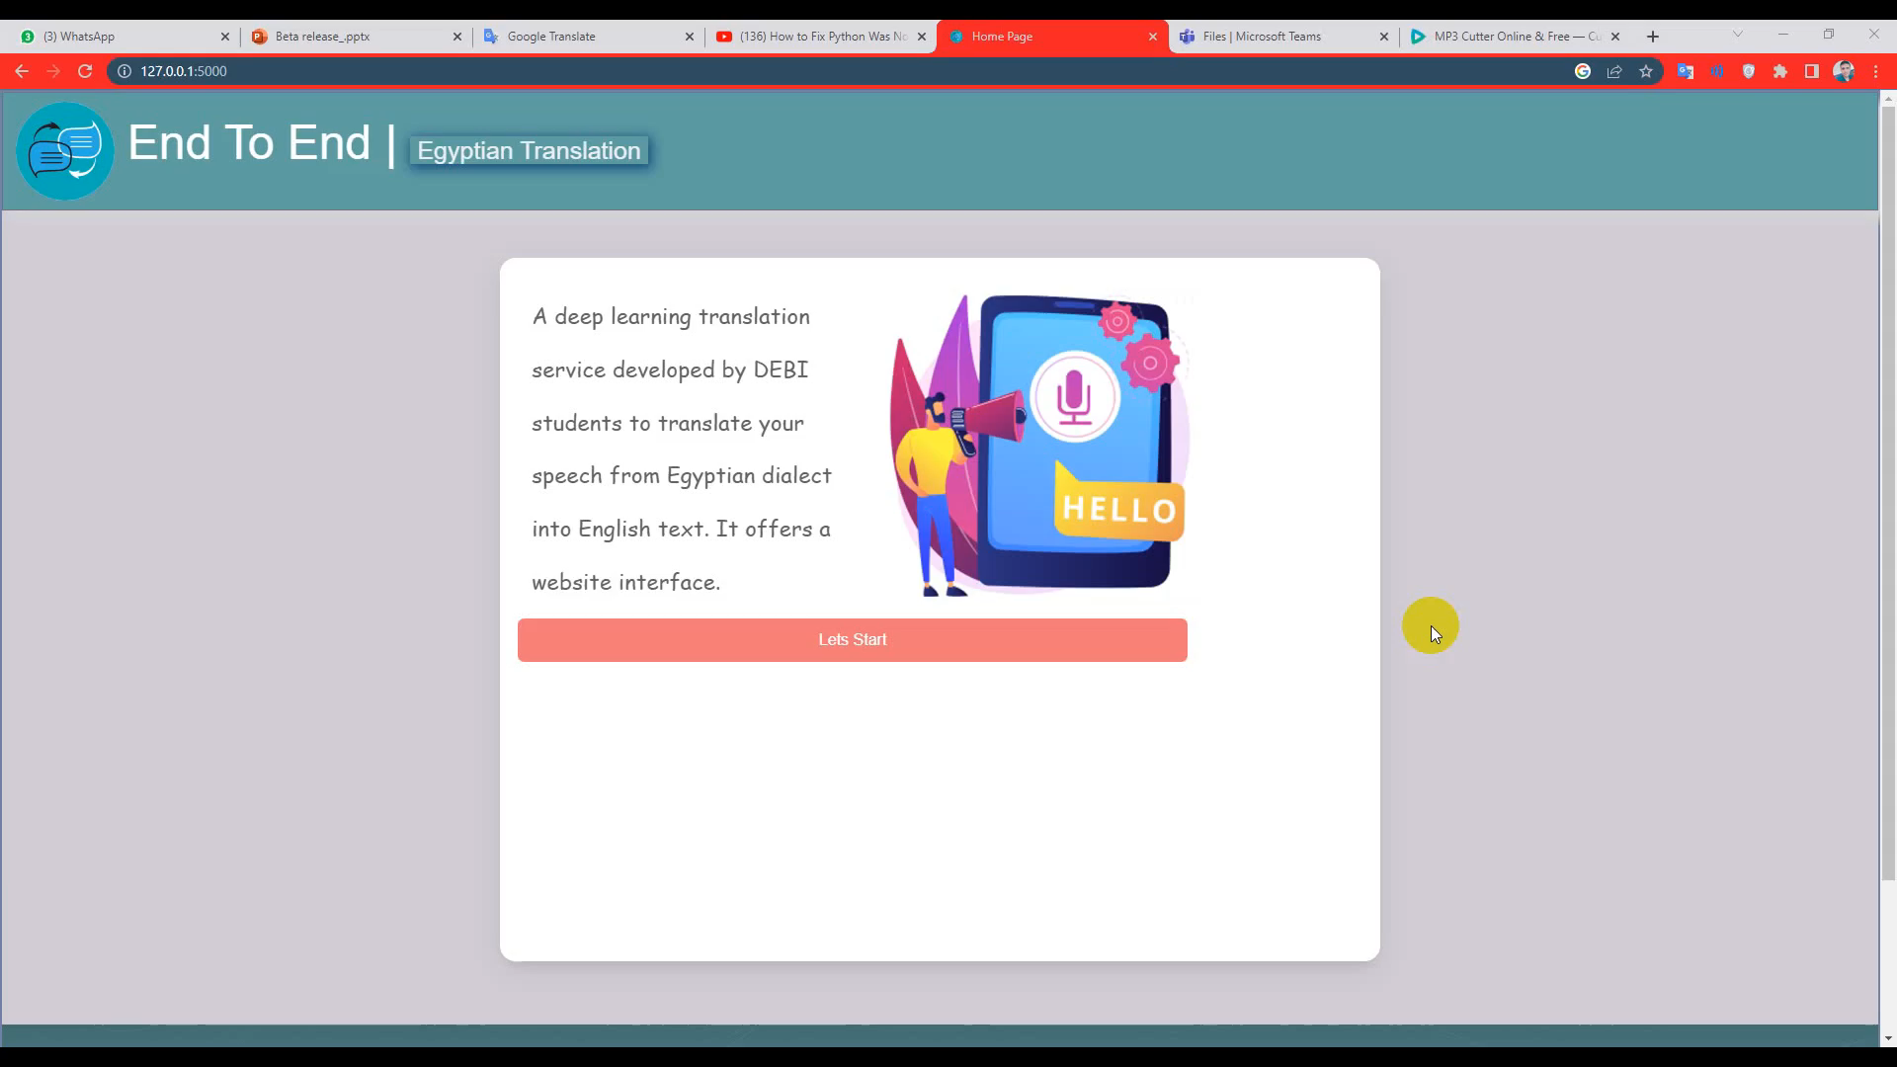
Project DEMO
Ahmed Abdo :300327306

Slide 17
References:-
[1] Audio Pre-Processing For Deep Learning
Link: https://www.researchgate.net/publication/347356900_Audio_Pre-Processing_For_Deep_Learning
[2]Denoising Speech for MFCC Feature Extraction Using Wavelet Transformation in Speech Recognition System DOI: 10.1109/ICITEED.2018.8534807
[3] Improving CTC Using Stimulated Learning for Sequence Modeling DOI: 10.1109/ICASSP.2019.8682700
[4]Sequence ModelingWith CTC Link: https://distill.pub/2017/ctc/
[5] Neural Machine Translation from Jordanian Dialect to Modern Standard Arabic DOI: 10.1109/ICICS49469.2020.239505
[6] CRAN: A Hybrid CNN-RNN Attention-Based Model for Arabic Machine Translation link: https://rdcu.be/cUtyt
[7]https://github.com/openai/whisper/tree/main/whisper

Slide 18
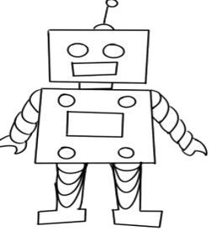
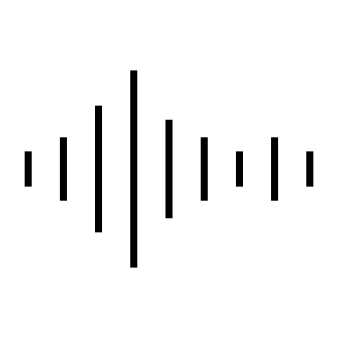

Thank You, Any Questions ?

